Slide 1
Why Use Logistic Regression
Logistic regression is a classification algorithm. It is used to predict a binary outcome based on a set of independent variables.
Ok, so what does this mean? A binary outcome is one where there are only two possible scenarios—either the event happens (1) or it does not happen (0). Independent variables are those variables or factors which may influence the outcome (or dependent variable).
To predict an outcome variable that is categorical from predictor variables that are continuous and/or categorical
Used because having a categorical outcome variable violates the assumption of linearity in normal regression
Logistic regression deals with this problem by using a logarithmic transformation on the outcome variable which allow us to model a nonlinear association in a linear way

Slide 2
Why Use Random Forest
Decision Trees are great for obtaining non-linear relationships between input features and the target variable.
Random Forrest is a series of decision trees
One big advantage of random forest is that it can be used for both classification and regression problems, which form the majority of current machine learning systems.
Another great quality of the random forest algorithm is that it is very easy to measure the relative importance of each feature on the prediction.

Slide 3
Why Use KNN
KNN works on a principle assuming every data point falling in near to each other is falling in the same class. In other words it classifies a new data point based on similarity.
We have properly labeled data.
Data is noise-free
Small dataset.
It’s a lazy prediction model

Slide 4
Why Use SVM
Sometimes, in real-world problems, linear separation is not possible, and there might be curved separating hyperplane for data classification of linearly inseparable data (overlapping data).
In such non-linear classification, the input data is mapped into high-dimensional feature space using non-linear functions (feature or kernel functions), and linear classifier is then used for data classification.
Some well-known kernel functions include Polynomial kernel, Gaussian kernel, sigmoid kernel, Radial basis function (RBF) kernel, etc.

Slide 5
Why Use Neural Network Multilayer Perceptrons (MLPs)
They are comprised of one or more layers of neurons. Data is fed to the input layer, there may be one or more hidden layers providing levels of abstraction, and predictions are made on the output layer, also called the visible layer
MLPs are suitable for classification prediction problems where inputs are assigned a class or label.
They are also suitable for regression prediction problems where a real-valued quantity is predicted given a set of inputs. Data is often provided in a tabular format, such as you would see in a CSV file or a spreadsheet.
Use MLPs For:
Tabular datasets
Classification prediction problems
Regression prediction problems
They are very flexible and can be used generally to learn a mapping from inputs to outputs.

Slide 6
Why Use TensorFlow Sequential
model is appropriate for a plain stack of layers where each layer has exactly one input tensor and one output tensor.
A Sequential model is appropriate when:
Your model does not has multiple inputs or multiple outputs
Any of your layers has single inputs or single outputs
Don’t need to do layer sharing
Don’t want non-linear topology (e.g. a residual connection, a multi-branch model)

Slide 7
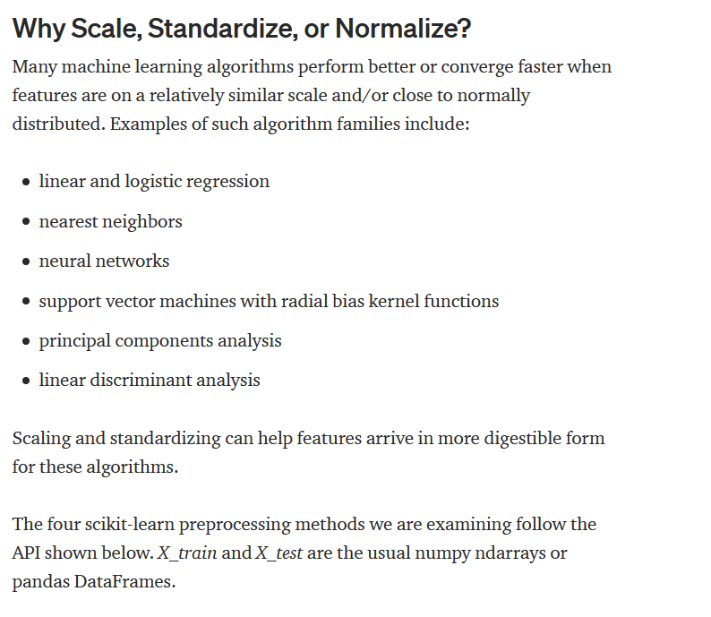
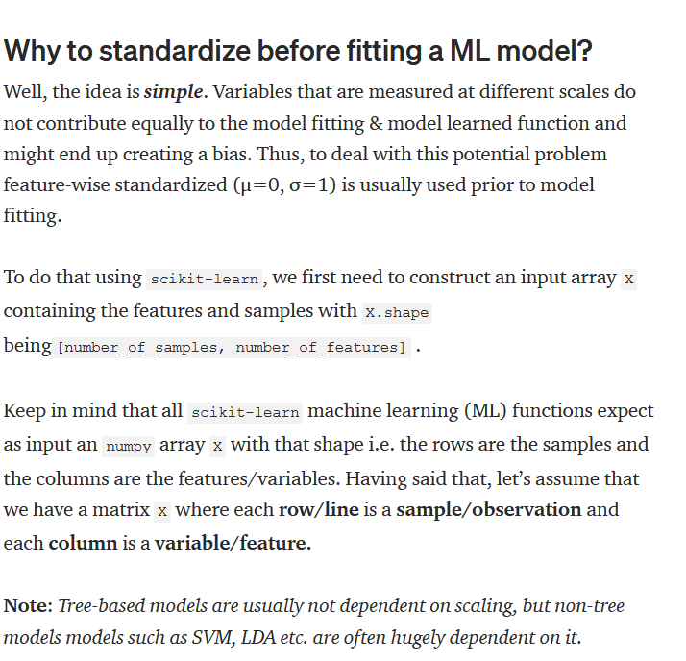
Why Standardize

